Slide 1

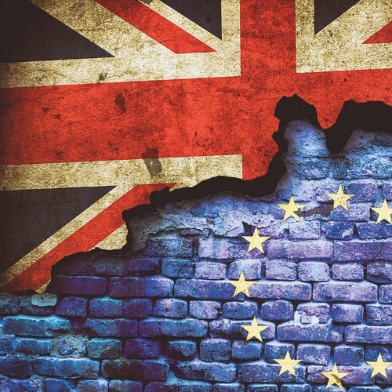
Brexit – What now?
Seamus Leheny
Policy Manager – Northern Ireland

Slide 2
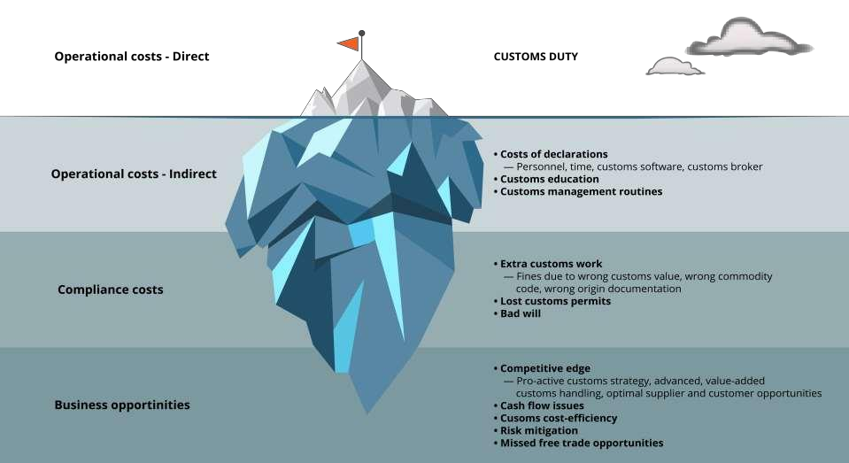
Brexit Cost Considerations

Slide 3
What we know
The UK intends to implement the Northern Ireland Protocol with effect from 1st January 2021
New customs & regulatory obligations will arise as a result of the Protocol
NI to GB trade:
UK government has stated unfettered access and no formalities
This contradicts EU requirement under Withdrawal Agreement that Exit Declarations are required
HMRC have confirmed for certain consignments leaving NI to GB will have to complete Pre-Lodgement Declarations and checks before departing NI Ports

Slide 4
What we know
GB to NI trade:
UK government has confirmed new formalities and checks on goods leaving GB to N
Regulatory controls will require enhanced and new infrastructure at Ports to facilitate Sanitary & Phyto-Sanitary controls
HMRC will require Pre-Import Declaration and a Safety & Security Declaration. Possibly a Transit Accompanying Document will be required.

Slide 5

HMRC Customs Requirements under the Protocol

Slide 6
GB to NI – Customs Procedures
Pre-Lodgement Model
Must be done before shipping ex GB
Risk assessed while at sea
Confirmation before arrival if consignment OK to proceed or if check required
Goods Vehicle Movement Service (GVMS) – IT Platform
This will link import declaration reference, safety & security, transit and vehicle registration references into one single reference presented at frontier.
Goods Movement Reference used to notify GVMS of consignment details, references (Vehicle, MRN), carrier and shipping details

Slide 7
GB to NI – Customs Procedures
Driver collects goods from trader and creates a goods movement reference (GMR)
One gmr per consignment
Driver must only proceed to port once Gmr is confirmed and correct

Slide 8
GB to NI – Customs Procedures
Driver presents GMR to ferry operator
Gvms uploads the gmr to hmrc
Invalid gmr = not authorized to ship
Once ship loaded, all gmr’S uploaded for to hmrc
Sailing time used to notify carriers what consignments are clear to proceed and what needs checked at arrival

Slide 9
NI to GB – Customs Procedures
Limited circumstances – Transit or Duty Suspended
Transit – Goods moving between NI & EU or ROI & GB/EU
Will require a declaration and Transit Accompanying Document.
GMR created to enable boarding at NI Port
Any checks MUST take place prior to boarding at NI Port
Exit Declaration?

Slide 10
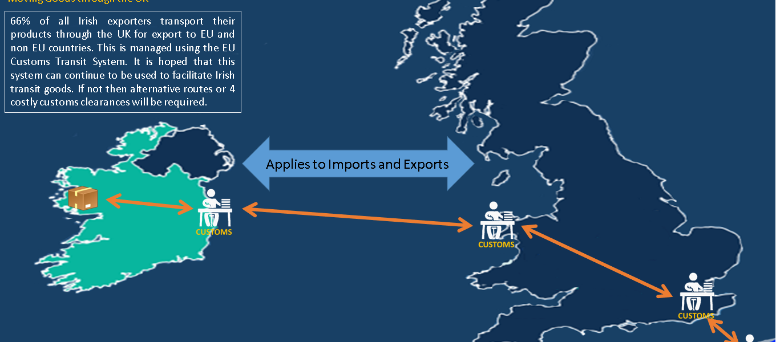
LANDBRIDGE TRANSIT ROI – EU – ROI

Slide 11
IMPORTS- GETTING STARTED
Pre importing- the basics:
Economic Operator Registration and Identification (EORI) number
Pre Notification of certain goods e.g. agri-foods, plants etc
Designation of UK border locations to import certain categories of goods
Presentation and certification of which categories of goods
Role of customs agents / forwarders
Notes:
TSP’s - HMRC have introduced simplified import procedures which specifically apply to the following:
Import of goods from the EU
Ro/Ro locations only
TSP is aimed at EU only traders. The advice to businesses involved in international trade presently is to complete full declarations.
These TSP arrangements are a temporary measure – and will be reviewed after 3-6 months. A 12 month notice period will be provided by HMRC before they are withdrawn.

Slide 12

Sanitary and phytosanitary (SPS) checks – UK → EU
Documentary checks
100%
Identity checks 100%
Physical checks
Up to 30%
Notes:
Three types of checks take place at these BIPs:
documentary checks, when authorities review the health certificates issued by sanitary authorities of the country of origin. These checks take place before the shipments arrive at the port; required for 100% of the products we mentioned at the beginning of this session. You need to provide one certificate for each batch, ie for each group of products of the same nature and same country of origin. I’ll go back to this in a minute.
identity checks, when authorities will check whether goods have been sealed and referenced properly; and that the information on the labels matches the sanitary certificates. In practice, French authorities have told us that on day 1, these checks would be kept to a minimum. In practice, this means that they will only check whether the seal is in place, and if they need to inspect live horses, each animal’s chip (one by one). Identity checks apply to 100% of live animals and animal-based products. They are not systematic for other products (eg. plants)
and physical checks, when boxes will be opened, temperature will be checked and goods might be tested. The percentage of controls vary from one type of goods to the other (eg. 20% for beef, fish, lamb… 50% for game, shrimps, dairy products or honey). For plant-based product, the percentage of physical checks also depends on the country of origin. But all in all, it’s much more than physical customs checks. We understand that France has asked the European Commission for a temporary relaxation of some of these rules – in particular with regard to physical checks – but are not certain how this has been received.
Tests in labs, which could take between 5 and 7 days, are fortunately quite a rare occurrence: only about 1% of controlled goods.
These products can only enter the EU through specific entry points, that are equipped with inspection facilities with specifically trained staff ➔carefully plan your route because not all ports are equipped with such facilities.

Slide 13


Sanitary and phytosanitary (SPS) checks – EU → UK
Actions for Northern Ireland importers:
Products of animal origin
Plant products managed under EU plant passport
Create a Government Gateway account
Register for IPAFFS now
Get familiar with the process to create a notification on IPAFFS (guidance)
Create a Government Gateway account
Create a PEACH account
Get familiar with the pre notification process (guidance)
Notes:
Products that are NOT covered by the new electronic process are likely to be subject to a notification requirement –not necessarily on day 1 but possibly after a few months.
As part of your No Deal preparations for your inbound flows of products of animal origin and plant-based products, reco = get ready for the pre notification requirements:
The current prenotification system for products of animal origin (TRACES) will be replaced by IPAFFS. You can register for IPAFFS and start using it for training purposes. IPAFFS will be necessary to:
pre notify your animal-based products originating from non EU countries from Brexit day
and to be able to pre notify high risk products originating from the EU (not necessarily on day 1 – but possibly at a later stage).
In the meantime as long as the UK is a member of the EU, the only case where you have to notify imports of POAO from the EU is if they originate from an EU country where safeguard measures are in place. In that case, and until Brexit day, continue using TRACES. For all other imports from the EU, no notification requirements.
Wrt plant products, only those currently managed under the EU plant passport scheme will require a pre notification in a No Deal Brexit scenario. You will need a PEACH account to notify these products. Don’t hesitate to consult official guidance on these 2 notification systems to get familiar with the processes.

Slide 14


Sanitary and phytosanitary (SPS) checks
Full set of SPS requirements
Risk-based approach
Notes:
Process for shipping such goods from the UK to the EU.
We know that the EU will implement the full set of requirements on these flows, just like for imports from the rest of the world, so it’s crucial you take the time to put in place the necessary procedures.
The entity that imports the goods in the EU first needs to obtain a sanitary or phytosanitary certificate from UK authorities. This certificate will need to be registered in TRACES. (Whilst TRACES will no longer be available for UK authorities to track whatever is imported into the UK, TRACES continues to exist and will still be used by EU authorities to track the flows that enter the EU). The certificate that will be registered in TRACES will also need to be transported alongside the goods as they enter the EU territory.
Trailers will need to be sealed. The reference number on the seal will be noted onto the sanitary or phytosanitary certificate.
All customs formalities apply to these products, of course.
You need to bear in mind that all products subject to SPS formalities coming from the UK will need to be pre-notified in the system TRACES. In practice, you will need to pre-notify information related to the shipments being exported into the EU in TRACES when the goods leave your premises.
The health certificate will need to be provided to the veterinarians in charge of the inspection of your goods.
You will need to open the trailer should detailed identity or physical checks be required.
Once the inspection is completed, you will receive a document called DVCE or DSCE. You will need this document to go with the goods. You are free to clear customs.

Slide 15
SPS costs to consider
Current EU charges applied for 3rd country SPS formalities:
Official controls: €55 per consignment up to 6 tonnes and €9 per tonne for consignments over 6 tonnes
Document Check: €7
Identity check: €7
Export Health Certificate: East Riding Local Authority charge £119 per hour

Slide 16
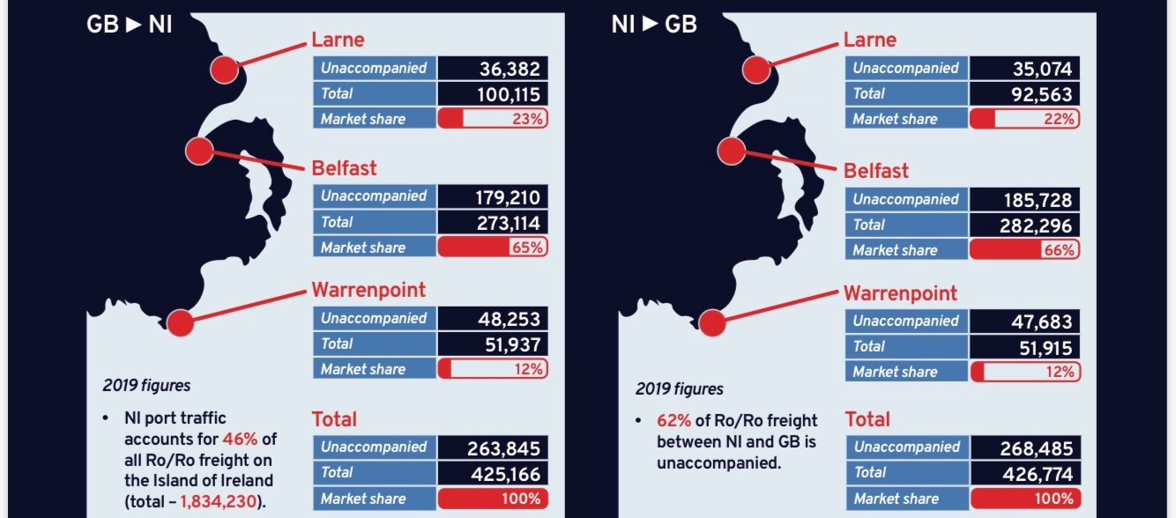
Ro/Ro volumes for NI

Slide 17
Our continuing Protocol Asks
Clarity and engagement
Derogations for qualifying trade flows
Assistance with cost of transition
Customs training and support
Simplified controls – transit, Dublin – Holyhead, checks in market

Slide 18
Thank You sleheny@fta.co.uk
@freight_ni

