Slide 1
Private & confidential: Not for Wider Dssemination
EU TRADE AND NI PROTOCOL ROADMAP.
A Presentation for Manufacturing NI
11 June 2020

Slide 2
EU-UK TRADE TIMELINE – THE NEXT FEW MONTHS
June 12 – Meeting of Joint Committee (Gove/Sefcovic).
June TBC – EU/UK High Level summit (stocktake on progress – Johnson/von der Leyen/Michel).
June 17/18 – European Council summit.
End June – Specialised Committee to meet.
July 1 – Date by which any extension of transition must be agreed within the Joint Committee.
Late June/early July – Next negotiating round.
October – Deal reached?
October – Legal text required to be finalised.

Slide 3
EU-UK TRADE TIMELINE – AGREEMENTS & DECISIONS in 2020
UK-EU Trade Agreement (PD, Para 3)
Irish Protocol Arrangements (WA, Protocol on ROI/NI, Art 5(2))
Equivalence – Financial Services (PD, Para 36)
Fisheries rights (PD, Para 74)
Adequacy Decision – Data (PD, Para 9)
end June end Dec

Slide 4
OTHER EU-UK AGREEMENTS required IN 2020 (1)
Haulage and road transport (PD, Para 60)
Maritime transport (PD, Paras 62-63)
Cross-border rail (PD, Para 61)
Air transport agreement (PD, Paras 58-59)
Labour mobility (PD, Paras 48-57)
end Dec

Slide 5
OTHER EU-UK AGREEMENTS required IN 2020 (2)
Security partnership (PD, Para 78)
Law enforcement and judicial co-operation
Nuclear co-operation agreement (PD, Para 66)
Security of information agreement (PD, Para 116)
Overarching Institutional framework (Governance)
end Dec

Slide 6
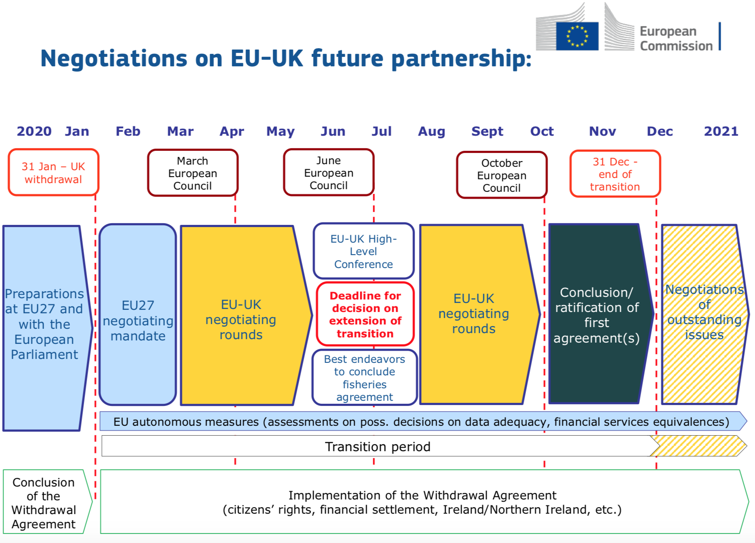

Slide 7
EU-UK TRADE – THE SCENARIOS
The following scenarios appear plausible:
No extension agreed in June – talks intensify through the summer.
No extension agreed in June – talks continue but reach crisis point by October with end of transition period looming. No trade agreement in place for 1 January. Both sides trade on their tariff schedules, WTO and other international agreements where possible, or no agreements where not.
No extension agreed in June – talks continue, and agreement is reached. Adjustment periods created.
Extension agreed in June – transition period extended until end December 2021. The least plausible option now.

Slide 8
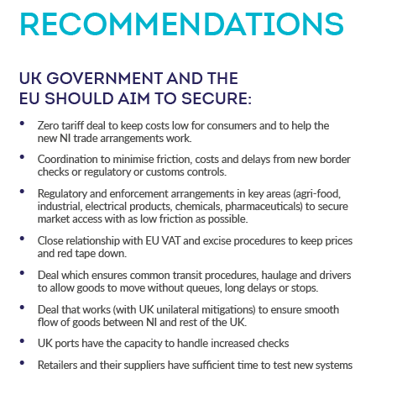

Slide 9
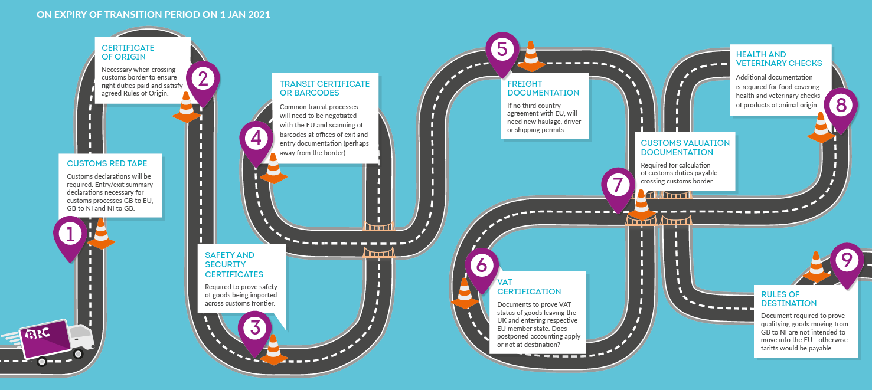

Slide 10
EU-UK TRADE – BUSINESS READINESS
What we know is changing:
VAT (imports/exports)
Customs (customs declarations and entry/exit summary declarations required)
What we don’t know:
Paperwork, databases and processes for the above
HMG attitude to GB border and other controls from inbound EU goods
Outcomes awaited on rules of origin, SPS, conformity assessment and product checks, Common Transit Convention processes, organics, tariffs, chemicals, medicines, pharma
Business needs more time to prepare (6-7 months?). How - if no extended transition period?
HMG guidance. Some exists for EU companies from the European Commission

Slide 11
THE NIBBWG KEY POINTS:
We welcome the first steps of progress
move from ambitions to technical detail very quickly
There’s a need for better access for business on this issue with both HMG (e.g. the Border Delivery Group) and the NI Executive
NI-GB and GB-NI detail is hugely important and needed now, but the integrated nature of the whole island economy is also important
The solutions that are brought forward need to reflect the needs of business and consumers e.g. applied trusted trader schemes
An education piece needs to be undertaken by government both in NI and GB about what the protocol implementation means in practice, especially for small business
Our overriding asks – for representation, mitigation, derogation and compensation – remain essential if NI is to safely navigate this upheaval
There is little bandwidth or financial capacity amongst the NI business community to deal with this now
There will be little bandwidth in January to deal with these changes either.

Slide 12
Next Steps
We will continue to meet with:
UKG
European Commission Task Force UK
Individual members states including Irish Govt
DG Trade
Westminster and devolved Committees
Feel free to get in touch
aodhan.connolly@brc.org.uk

