Slide 1

UK Points-Based Immigration System:
Practical Impacts for Northern Ireland Businesses
10 December 2020

Slide 2


Welcome and Introductions
Shane Murphy, Head of DfE EU Exit Preparation & Transition Group

Slide 3
Programme
 | Item
14.10 | The New Points-Based Immigration System – What does it mean for Northern Ireland Businesses? Dan Petriello, Carrie Golding & colleagues, Home Office
14:50 | Your Questions, Answered
15:20 | Support available to Northern Ireland businesses Invest NI – Adrienne Perry, Brexit Team, Invest NI InterTradeIreland - Deirdre Maguire, Brexit Advisory Service Manager
15:40 | Final Q&A
15:55 | Wrap Up
16:00 | Close

Slide 4
The UK’s Points-Based Immigration System and the EU Settlement Scheme
December 2020

Slide 5
The EU Settlement Scheme and Frontier worker permit
Key information and resources

Slide 6
EU Settlement Scheme
During that period employers, landlords and public service providers will continue to accept the passports and national identity cards of EU citizens as evidence of permission.
EU citizens living in the UK by 31 December 2020 are eligible to apply to the EU Settlement Scheme and have until 30 June 2021 to make an application.
There have now been more than 4.48 million applications to the EUSS with over 4.28 million grants of status. *
*as of 30/11/20

Slide 7


Further Information
NI specifics
72,700 applications in Northern Ireland
Northern Ireland 64% Settled status compared to 56% overall
Top 5 NI nationalities Poland, Lithuania, Romania, Portugal and Bulgaria
Top 5 NI locations
NI support
Advice NI
Migrant Centre NI
South Tyrone Empowerment Programme
Further support
Settlement Resolution Centre helpline for organisations supporting applicants
Stakeholder toolkits with:
    Posters
    Social media assets
    Videos
    Presentations
Bespoke guidance
Translated guidance in 26 languages
Employer, local authority and community group toolkits
GOV.UK
    Visit the website
    gov.uk/eu-settled-status to:
        Get email alerts
        Get more details on the EU Settlement Scheme
        Find out about next steps and citizenship
Armagh City, Banbridge and Craigavon
Belfast
Mid Ulster
Newry, Mourne and Down
Mid and East Antrim

Slide 8
Frontier Workers Permit Scheme
The Withdrawal Agreement protects the right of frontier workers to continue to come to the UK to work after free movement ends on 31 December 2020.
A protected frontier worker must:
        be a citizen of the EU, Switzerland, Norway, Iceland or Liechtenstein
        live outside the UK (and therefore not be primarily resident in the UK)
        be employed or self-employed in the UK on or before 31 December 2020 and continue to work here
Today, 10 December 2020, the Government opened the frontier worker permit scheme so protected frontier workers can apply for and be issued with a permit.
Applications are online, free of charge, and can be made from within or outside the UK.

Slide 9
Frontier Workers Permit Scheme
Until 1 July 2021, protected frontier workers can continue to enter the UK for work using a valid passport or national identity card.
From the end of the grace period (1 July 2021) non-Irish frontier workers will be required to hold a valid frontier worker permit in order to enter the UK for work.
Irish citizens do not need to apply for a frontier worker permit to come to the UK for work, but they can choose to do so if they wish.
        A frontier worker permit will last for 5 years, or 2 years if obtained on the basis of ‘retained worker’ status.
        Further information, see: www.gov.uk/frontier-worker-permit

Slide 10
The UK’s Points-Based
Immigration System
Overview of key routes and resources

Slide 11
Overview
On the 1st December the Government launched a number of routes under the UK’s new points-based immigration system, including the Skilled Worker route. Applicants for the new routes can now start to apply under the points-based system.
The following publications have provided information to employers and applicants over the past year:
The policy statement on the UK’s Points-Based System published on 19 February 2020 set out the overall parameters for the new system.
On 13 July 2020 the Home Office published an additional statement which provided further details to applicants, employers and educational institutions on the draft requirements and conditions underpinning the key immigration routes. The statement covered the main economic migration routes for those wishing to apply to work or study or set up a business in the UK. It also set out our provisions for visitors.
On 22 October the Home Secretary laid changes to the Immigration Rules that underpin the new Points-Based System to replace freedom of movement.
Irish citizens will continue to be able to enter the UK under the Common Travel Area arrangements. They do not need to apply to the EU Settlement Scheme or under the new points-based system.

Slide 12
The UK’s Points-Based
Immigration System
The skilled worker route and sponsorship

Slide 13
Skilled worker route
The points-based system will include a route for skilled workers, both EU and non-EU citizens, who meet the following requirements:
Job offer from HO approved sponsor
Speak English
Criminality threshold
Skill level
RQF3 (A-level and equivalent) and above
What’s new for the skilled worker route?
No cap on numbers​
No Resident Labour Market Test​
Expanded skills threshold – now RQF3 (equivalent to A-level) and above​
Tradeable points – points for certain characteristics will be tradeable against salary ​
The 12-month “cooling off period” and six-year maximum length of stay in the route are being removed
Relevant salary
-Either the general salary threshold or going rate, whichever is higher

Slide 14
Skilled worker route
Every applicant must score at least 70 points to be eligible for the skilled worker route.
50 of these points must come from meeting the mandatory criteria below.
MA
ND
A
T
OR
Y
Job offer from an approved sponsor
Non-
tradeable
points
Skill level RQF3 or above
Total = 50 points
English language
The remaining 20 points can be made up by trading points in one entry from each of the two categories (‘salary’ or ‘other’) below.
Applicants must earn more than the lower limit of £20,480 in order to be eligible to trade points.
80% of relevant salary– 0 points
90% of relevant salary– 10 points
100% of relevant salary– 20 points
Salary
Tradeable
points
Relevant PhD to job – 10 points
Relevant STEM PhD to job – 20 points
Job in a shortage occupation – 20 points
Other

Slide 15
Skilled worker route – case study
Richard wants to come to the UK to work and has been offered a job as a Mechanical engineer for a salary of £26,750. He meets all of the mandatory characteristics under the Points-Based System, scoring 50 points.
As the going rate for mechanical engineers is £33,400 and higher than the general salary threshold, he must be paid according to the going rate for that occupation. This is because applicants must be paid according to whichever of the two is higher. Richard’s salary is just above 80% of the going rate for his occupation, therefore while he scores no points from his salary, he is eligible to score 20 tradeable points elsewhere to be eligible for a visa. In this instance Richard scores the 20 extra points by having a job offer in a shortage occupation.
 | Characteristic | Points | Total
Mandatory | Offer of a job by an approved sponsor | 20 | 50
 | Job at an appropriate skill level | 20
 | English language skills at level B1 (intermediate) | 10
Tradeable | Salary at least 80% of the going rate | 0 | 20
 | Job in a shortage occupation (as designated by the MAC) | 20
Total |  | 70

Slide 16
Skilled worker route – case study
Tommy wants to come to the UK to work and has been offered a job as a general manager for a salary of £26,300. He meets all the mandatory criteria under the Points-Based System, scoring 50 points.
Tommy’s salary is higher than the £25,600 general salary threshold; and it is above the £22,700 going rate for general managers, so he scores 20 points for his salary.
General managers are not listed as a shortage occupation, so Tommy does not score any points for his occupation.
 | Characteristic | Points | Total
Mandatory | Offer of a job by an approved sponsor | 20 | 50
 | Job at an appropriate skill level | 20
 | English language skills at level B1 (intermediate) | 10
Tradeable | Salary at least the going rate for the profession | 20 | 20
 | Job in a shortage occupation (as designated by the MAC) | 0
Total |  | 70

Slide 17
English language requirement
The UK requires individuals coming to the UK to demonstrate that they have an appropriate level of English, as outlined in the Immigration Rules. Being able to speak English is a minimum requirement that every skilled migrant must be able to meet.
As well as being able to take a secure English language test, we are increasing the number of ways it is possible for applicants to meet this requirement:
Ensure applicants only need to prove the required level of English language to the Home Office once;
Update the majority speaking English language country list to include Malta.
Allow applicants who have gained GCSE/A-Level or Scottish Highers in English while at school in the UK to rely on this to prove their English language ability.

Slide 18



Employing a worker- sponsorship
A streamlined, faster process with no Resident Labour Market Test, suspending the current cap on Tier 2 visas and no monthly panel to apply for Certificates of Sponsorship. This will mean time savings for employers of initially up to 8 weeks.
Employers do not need to be a sponsor to employ someone from the resident labour market with an existing right to work in the UK. This includes EU citizens with settled or pre-settled status.
Employers need to apply to be a sponsor if they want to recruit workers from outside the resident labour market.
We will allow most migrants to apply to switch from one immigration route to another without having to leave the UK. However, there will be no relaxation of the qualifying criteria for the route being switched into.
There will be longer term reforms to the design and user interface of the sponsorship process in 2022, which we will test with stakeholders.

Slide 19
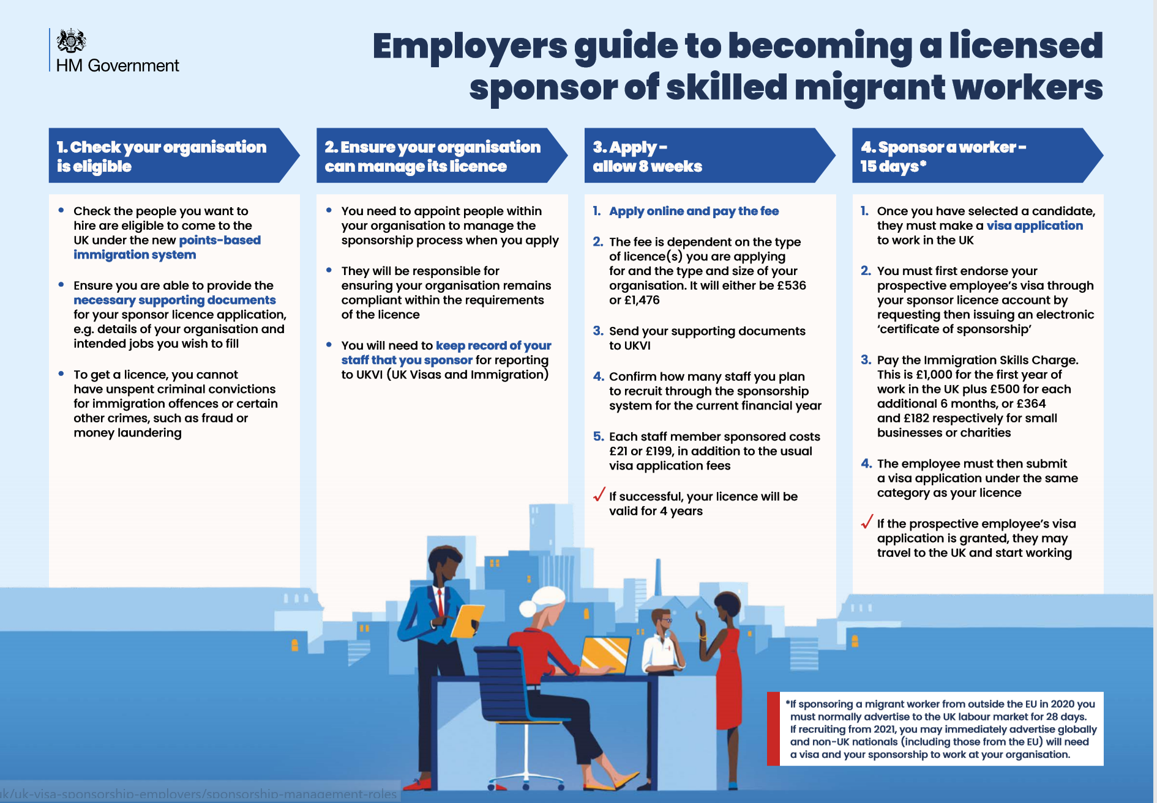

Slide 20
The UK’s Points-Based
Immigration System
Other routes

Slide 21
Highly skilled workers- overview
For January 2021 we will extend the current Global Talent route to EU citizens on the same basis as non-EU. Under the Global Talent route, the most highly skilled workers who can achieve the required level of points, will be able to enter the UK without a job offer if they are endorsed by a Home Office recognised endorsing body.
The main changes to the Global Talent route announced on 22 October are:
The criteria for consideration of senior appointments are being revised, so that the route caters for emerging leaders as well as those at a more advanced stage of their career.
The definition of the types of academic and research roles that qualify is being expanded.
A points assessment is being introduced in line with the introduction of the points-based system.
Longer term, we will create a new broader unsponsored route. This would allow a small number of the most highly skilled workers to come to the UK without a job offer. We will explore this with stakeholders in the coming year.

Slide 22
Those who don’t meet skills and salary thresholds
The UK Points-Based Immigration System will not include a route for those who do not meet skills and salary thresholds
Focus on UK resident labour market
Over 4.48 million EU nationals have already applied to stay in the UK
An estimated 170,000 non-EU citizens in lower-skilled occupations
Seasonal workers pilot will provide employers in the agricultural sector with further flexibility
Greater flexibility for employers with changes to salary and skills thresholds

Slide 23
Other immigration routes
For January 2021
For a number of the main economic routes the main change that will be implemented for January 2021 is bringing EU citizens into the current non-EU routes. Examples of these include:
Start-up and Innovator
Intra-Company Transfers
Youth Mobility Scheme
Sporting
Creative
Charity
Ministers of Religion and Religious Workers
Government Authorised Exchange
International Agreement
UK Ancestry
Simplification
Underpinning these routes and the Points-Based System as a whole will be simplified rules and guidance. We will make the best use of technology and implement the recommendations of the Law Commission to streamline and simplify the immigration system.

Slide 24
Visitors
Anyone can apply to visit the UK. They must either apply for a visa before arrival or seek leave to enter at the UK border. Visa nationals can apply anywhere outside the UK. Non-visa nationals can apply at the UK border. The UK Government has already said that its intention is for citizens of the EU and Switzerland to not require visas to visit the UK.
In most cases, visitors can come to the UK for up to six months. A visitor may enter the UK multiple times, but they may not live in the UK by means of repeat visitors. They may not work or access public funds.
We have simplified the visitor rules to:
Permit study of up to six months under the standard visit route. All non-recreational study must be undertaken at an accredited institution, except recreational courses undertaken for leisure that last no longer than 30 days.
Remove the requirement for volunteering to be incidental to the main reason for the visit.

Slide 25
Visitors – more information
If you’re visiting for tourism or leisure
You can visit the UK to:
spend time with friends and family
take a holiday
do a recreational course of up to 30 days, for example a dance course
volunteer for up to 30 days with a registered charity
take part in a school exchange programme
If you’re visiting on business
You can visit the UK for many different business reasons, including attending meetings, conferences, trade fairs or negotiating contracts. You can do certain business activities with UK employees of the company you work for overseas, for example provide training or share knowledge on internal projects.
Check the Visitor Rules for the full list of business activities you can do as a Standard Visitor and any additional eligibility requirements.
If you’re being paid by a UK organisation to visit as an expert in your profession, you should apply for a Permitted Paid Engagement visa.
If you’re visiting to study
You can visit the UK to study for up to 6 months at an accredited institution, this includes English language courses.
You can also do:
a short piece of research that’s relevant to your course overseas
an ‘elective’ - an optional additional placement, if you’re studying medicine, veterinary medicine and science, or dentistry
If you want to study longer, you’ll need to apply for a:
Student visa (if your course is run by a licensed sponsor)
Short-term study visa (for English Language courses up to 11 months)
If you’re visiting as an academic
If you’re from an academic institution overseas, you can:
take part in formal exchange arrangements with UK counterparts
carry out your own research during a sabbatical
If you’re a senior doctor or dentist you can also:
take part in research
teach (as long as it is not a permanent teaching post)
undertake clinical practice (as long as it’s not a permanent position)

Slide 26
Application fees
Application fees will continue to apply under the new system as they do now, and a list of current fees can be found on GOV.UK.
They will apply to both EU and non-EU citizens.
Visa fees can be found here: https://www.gov.uk/government/publications/visa-regulations-revised-table/home-office-immigration-and-nationality-fees-1-december-2020
They vary by route and duration of the visa.
Under the skilled work route discounted rates apply for those applying for roles in a shortage occupation and for those applying for a Health and social care visa

Slide 27



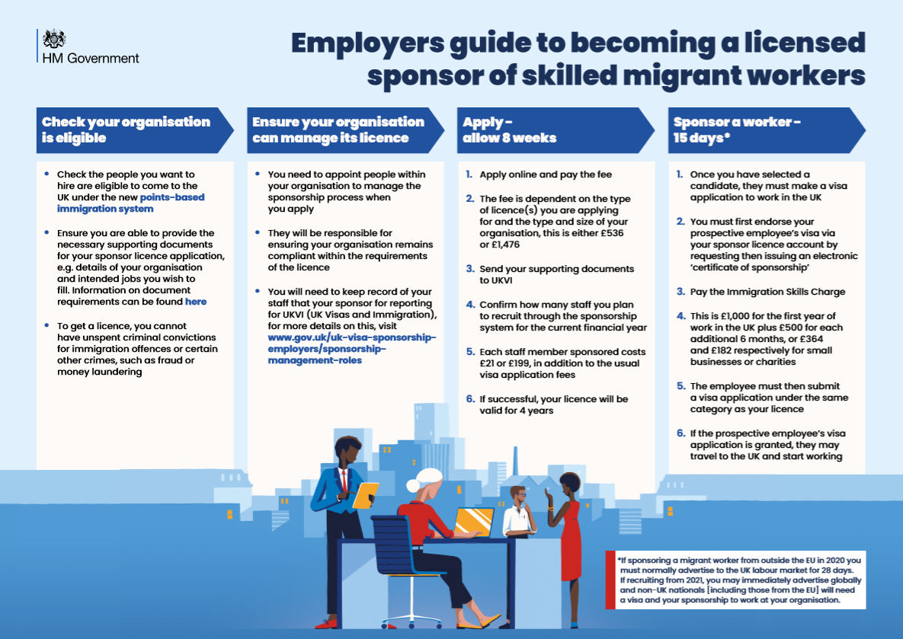




Available GOV.UK resources/assets
Guides
EU citizens guide
EU students guide
Employers Guide
Sponsor Guide
Social assets
EU citizens
EU students
Sponsoring a worker
Hiring outside of the UK

Slide 28



Available GOV.UK resources/assets
UKVI toolkits
Global Talent visa
Skilled worker visa
Graduate Immigration Route
Useful links
New immigration system: what you need to know:
https://www.gov.uk/guidance/new-immigration-system-what-you-need-to-know
UK points-based immigration system: employers and EU citizens
https://www.gov.uk/government/collections/uk-points-based-immigration-system-employers-and-eu-citizens
Recruiting people from outside the UK from 1 January 2021
https://www.gov.uk/guidance/recruiting-people-from-outside-the-uk-from-1-january-2021
Home Office Podcast available on Apple, Acast and Spotify
https://open.spotify.com/episode/4ljr2e4DONeYmDToPBykds?si=p83RqzWtTG6y73WX2TeRPQ

Slide 29
Your Questions, Answered

Slide 30
Your Questions, Answered:
Thank you for sending us your questions in advance of today’s webinar. They included questions about:
Shortage Occupation List
Settled Status & the Immigration Grace Period
Sponsorship - Process & Compliance
Routes for short-term placement / temporary contracts
The status of the Seasonal Agricultural Workers Pilot post 1 Jan 2021
Fees/surcharges, and who pays them
Rules for Visitors & Permitted Paid Engagement
PBIS-based HR queries – including questions about recruitment processes/employer obligations, evidencing a Genuine Job Offer (with the removal of the Resident Labour Market Test), assessment of skills threshold for vacancy, determination of salary/going rate
Direct Home Office support for employers
Please use the Q&A function on the screens to ask further questions during this session and we’ll try to cover as many as we can.

Slide 31
Support for Businesses

Slide 32
UK Points-Based Immigration System
Adrienne Perry, Brexit Team, Invest NITeam, Invest NI

Slide 33
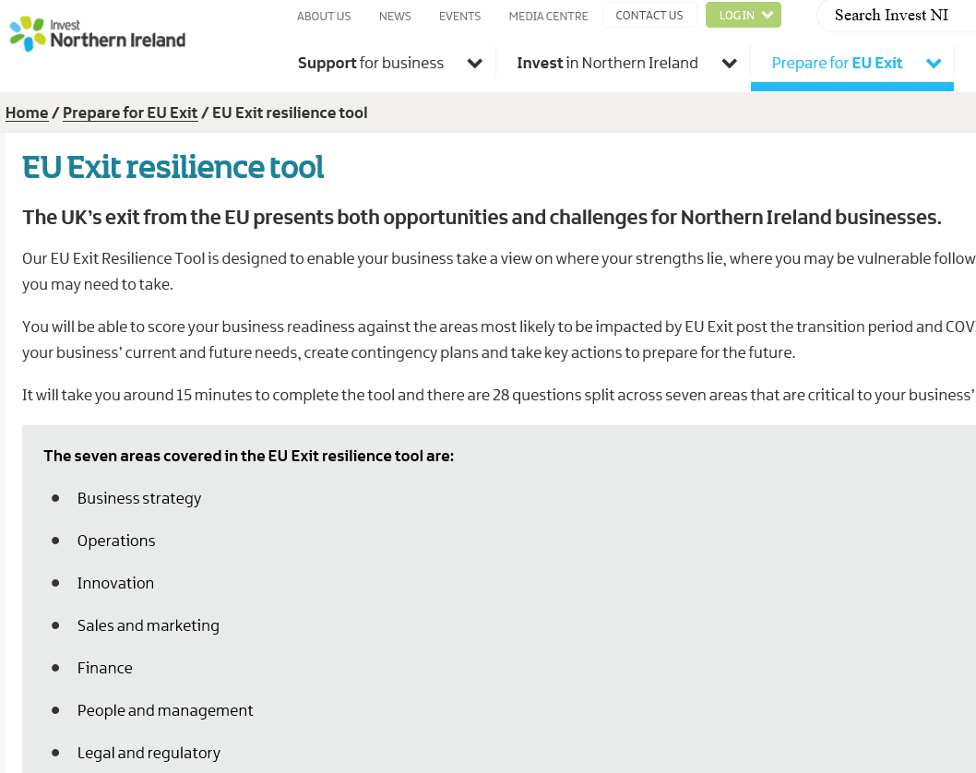
Resilience Tool
7 key areas
Assess readiness
Key actions

Slide 34
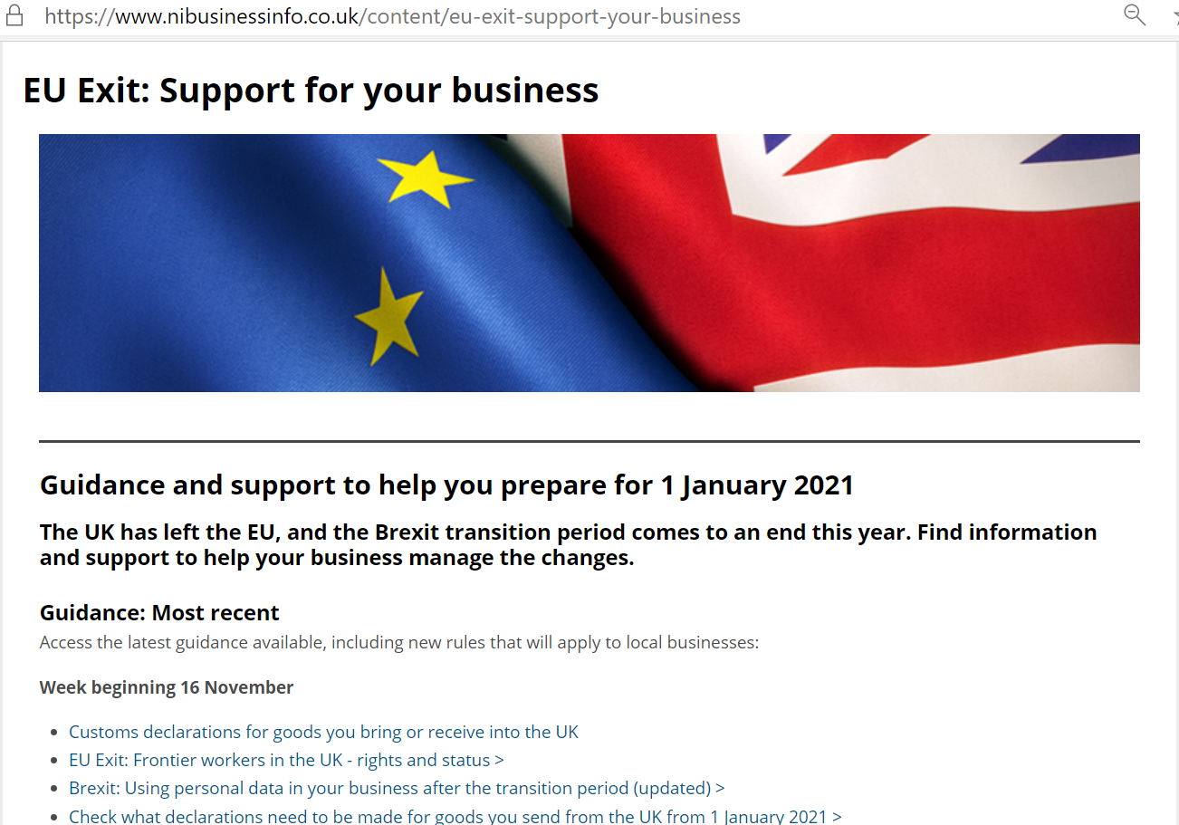

Support for employers
Points based system
Register for weekly updates

Slide 35
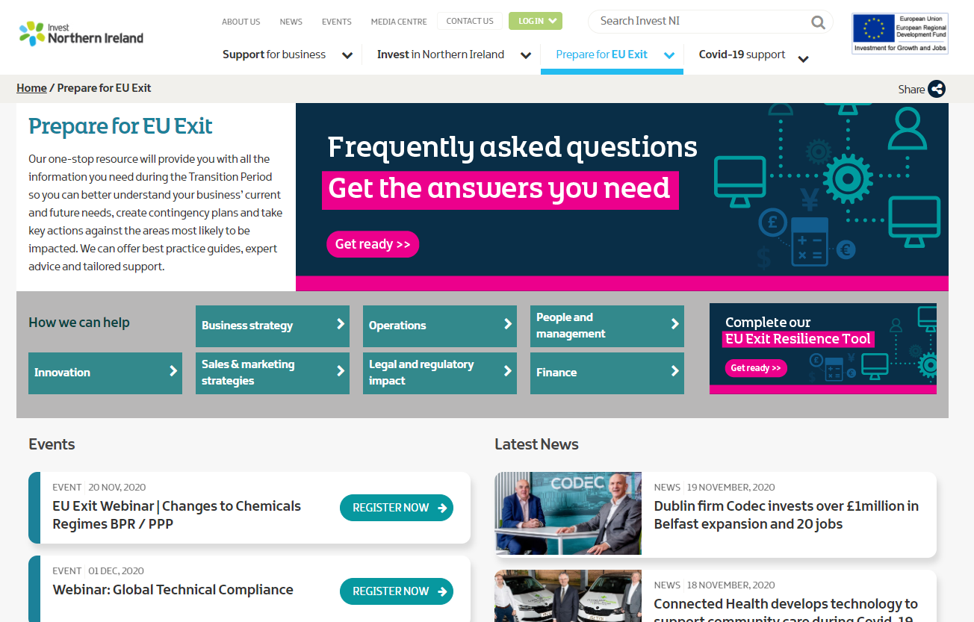
People FAQs
Immigration tutorial
Advice Clinics

Slide 36
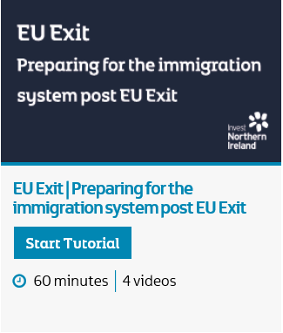
Immigration webinar
Pre EU Exit rights
Employer guidance
key actions
Notes:
Chapter List
Chapter 1 - Pre-EU Exit Rights for EEA Nationals and the EU Settlement Scheme
Chapter 2 - Post EU Exit Immigration System
Chapter 3 - Employer guidance and what you can do now to prepare.
Chapter 4 - Questions and Answers
In this webinar Jonathan Simpson from employment law specialists A&L Goodbody delivers an hour-long webinar, explaining the current situation for EEA workers in the UK and the actions that are required to apply to the EU Settlement Scheme. He will cover changes to immigration rules from January 2021, the implications these will have on your business and what you can do to prepare.

Slide 37



Top 10 Actions
EU Settlement Scheme & Apply for an Immigration Sponsorship Licence
FAQs: investni.com
Video: Preparing for the immigration system

Slide 38
Online Workshops
EU Exit Workshops: Preparing for change advice clinic | 15 December 2020 10:00 – 14:00
Already planning more 1-2-1 advice clinics for January 2021
To book click here
38

Slide 40
InterTradeIreland Brexit Advisory Service
Brexit Voucher Support
£2,000 / €2,250 fully funded financial support towards professional advice to help in the areas
Supply Chain
People
Finance
Customs
General Brexit Risk Review
        Eligibility Criteria & online application process https://intertradeireland.com/brexit/funding

Slide 41
InterTradeIreland Brexit Advisory Service
Digital Content https://brexit2020.intertradeireland.com/
Trade in Goods
Trade in Services
People
Latest Update
FAQ’s and Events
    https://intertradeireland.com/brexit

Slide 42
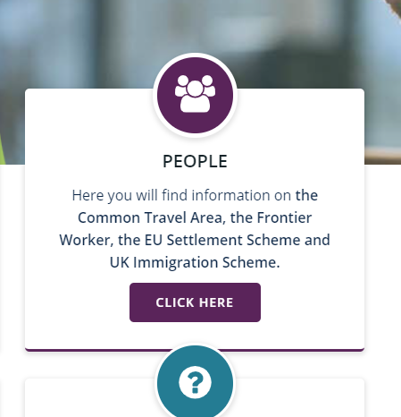
Digital Content
    https://intertradeireland.com/brexit

Slide 43
Digital Content
    https://intertradeireland.com/brexit
Introduction- Introducing you to a simple guide to the EU Settlement Scheme and the post-Brexit immigration scheme with a focus on The Common Travel Area and Frontier Workers.
Employee Information - What does the EU Settlement Scheme mean for employees with tips, help and support.
Employer Information - What does the EU Settlement Scheme mean for employers, how employers can help employees, along with tips, help and support.
Key Information – Cross Border Traders - This guide provides detailed information on what cross-border traders need to do in preparation for January 2021.
British passport holders & their family members living in Ireland - If you are a British passport holder (or their family member) and you live in Ireland, this information will help you understand what Brexit means for you.
New Immigration -System - Details on the new points-based immigration system.
FAQs
These are frequently asked questions relating specifically to the EU Settlement Scheme and the post-Brexit immigration scheme

Slide 44
InterTradeIreland Brexit Advisory Service
Know where to get support
Tip - One thing a day and share the tasks if you can
UK Gov Transition Site https://www.gov.uk/transition
DETE Ireland Brexit Readiness Checklist and list of supports https://enterprise.gov.ie/en/Publications/Brexit-Readiness-Checklist.html
Contact us
brexit@intertradeireland.com
https://intertradeireland.com/brexit

Slide 46
Questions & Answers

Slide 47
Thank you for your time.
You will receive the slide pack from today’s webinar which includes links to further information and support.
You will also get a post-event evaluation survey so that you can tell us what you thought about the event, and make suggestions about future events you might find helpful.
If you have any further questions, please contact us at EUExitMigration@economy-ni.gov.uk

