Slide 1

Update on the Northern Ireland Protocol

Slide 2
The Northern Ireland Protocol`
The Northern Ireland Protocol has been designed as a practical solution to avoiding a hard border on the island of Ireland whatever the trading arrangements are between the UK and the EU.
The staged approach that applies in GB to EU-GB movements will not apply in Northern Ireland.
Under the protocol the UK Government will:
Deliver unfettered access for NI producers to the whole of the UK market;​
Ensure there are no tariffs on goods remaining within the UK customs territory; ​
Give effect to our obligations without the need for any new customs infrastructure in Northern Ireland; and​
Guarantee that NI businesses will benefit from the lower tariffs we deliver through our new Free Trade Agreements with third countries. ​

Slide 3
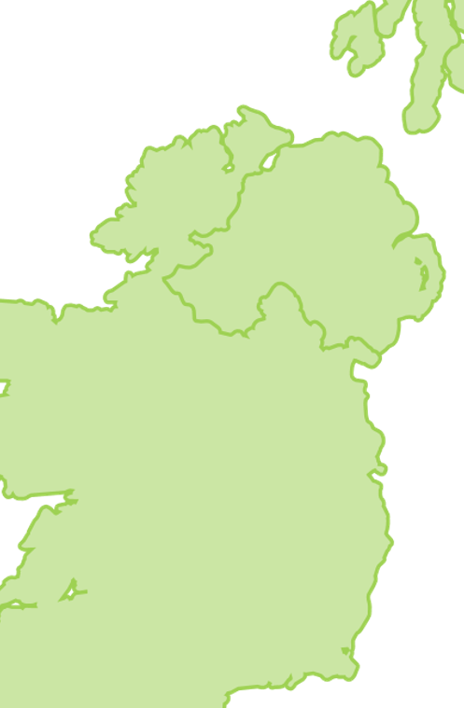
1. NI and IE
No hard border
No physical infrastructure
No checks or processes
No customs duties or tariffs
1. IE-NI

Slide 4
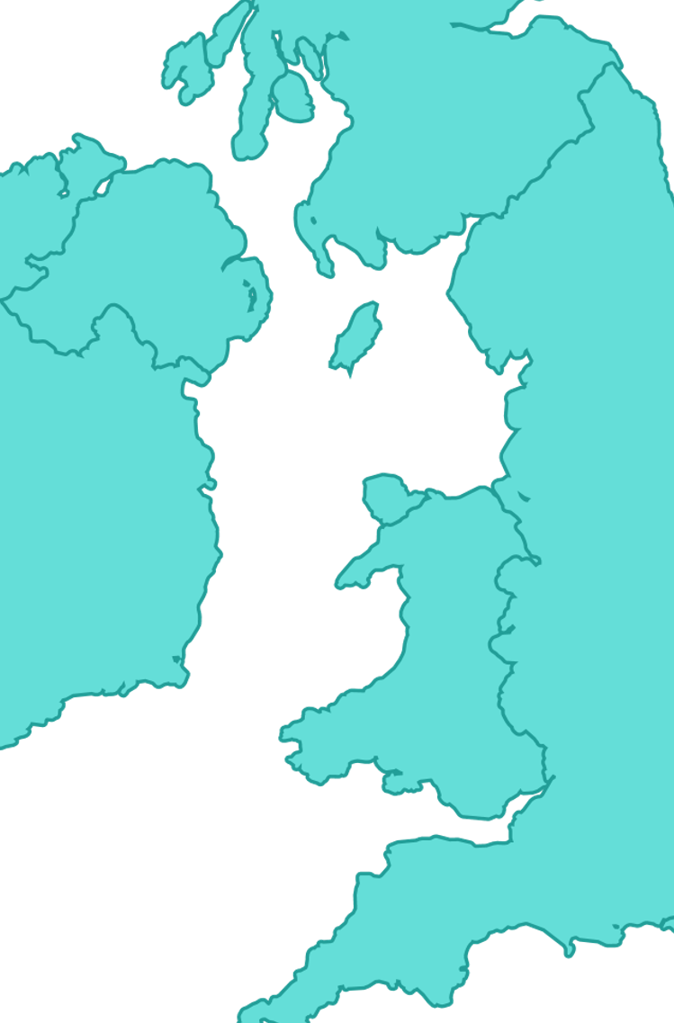
1. NI to GB (Unfettered Access) – Movement of Goods
The UK Government will guarantee unfettered access for Northern Ireland’s businesses to the rest of the UK internal market from 1 January 2021, ensuring that direct trade from Northern Ireland to Great Britain continues, for the majority of businesses, as it does now.
No import customs declarations or entry summary declarations as goods enter the rest of the UK from Northern Ireland
No tariffs applied to Northern Ireland goods entering the rest of the UK in any circumstances
No customs checks
The only extremely limited exceptions where goods movements require bespoke processes, for example to take account of specific international obligations binding on the UK or the EU.
Goods placed under a customs special procedure in NI
Transit movements
Goods on a list of 14 prohibitions and restrictions where export declarations are required
Goods that start their journey in the EU and come to GB via NI will have to comply with export requirements in their home Member State.
Indirect movements
NI-ROI-GB will benefit from an override of the tariff on entry to GB. These goods movements will have to comply with EU export procedures to depart through ROI.
2. NI to GB

Slide 5
2. NI to GB (Unfettered Access) – Movement of Goods
From 1 January 2021, the first phase of unfettered access will apply to goods in free circulation in Northern Ireland.
This will be supported by anti-avoidance provisions to tackle any EU businesses who seek to route their goods through Northern Ireland to avoid the UK’s customs regime.
Purchasers from Great Britain who buy Northern Ireland goods are not liable for tariffs, whether they move goods directly or via Ireland.
We will bring in a long-term regime in the second half of 2021 which focuses its benefits on those businesses established in Northern Ireland.
This will identify “qualifying” traders as they ‘check in’ in the usual way at ports and airports, meaning that the system will be light-touch - with many traders auto-enrolled in the scheme - while still ensuring that goods are free of checks, controls or tariffs when moving from Northern Ireland to Great Britain.
We will introduce specific arrangements for agri-food trade, while ensuring that these do not impose any additional burdens for manufacturers or other traders using Northern Ireland ports.
2. NI to GB

Slide 6





3. GB to NI – Changes to Processes
The Protocol entails some new administrative processes for traders moving goods from the UK to Northern Ireland:
new digital import declaration requirements, and
digital safety and security declaration
These processes, which will be administered by UK authorities in the form of HMRC and Border Force, are needed to make sure that:
tariffs are not paid on trade within the UK
that Northern Ireland can benefit from UK FTAs, and that goods destined for Ireland and the EU (i.e. at a genuine and substantial risk of doing so) pay tariffs when they should.
It is important to note that the ultimate destination of goods and whether, for example, traders will be selling them in Northern Ireland or moving them on to Ireland/the EU, will become relevant in the future.
These digital processes will be streamlined and simplified to the maximum extent, and will not require any export declaration, exit declaration, or customs and regulatory clearance for goods as they leave the rest of the UK for Northern Ireland.
Furthermore, the new Trader Support Service will ensure that the process is straightforward even for businesses who have not previously engaged with customs, and that no direct costs are incurred.
3. GB to NI

Slide 7
4. GB to NI – The Trader Support Service
The UK Government have established a new, free to use digital service. The Trader Support Service (TSS) will help GB-based businesses and traders of all sizes to navigate the changes to the way goods move once the Northern Ireland Protocol comes into effect on 1 January 2021.
TSS will offer education and advice to help traders understand and prepare for the upcoming changes, provide support with declarations for goods moving from Great Britain to Northern Ireland and provide contact centre support.
If your business is impacted by the changes, you should register for Trader Support Service. It can help you if you:
Move goods between Great Britain and Northern Ireland
act on behalf of someone to move goods between Great Britain and Northern Ireland
are based in Northern Ireland and receive goods from outside of Northern Ireland
send parcels between Great Britain and Northern Ireland, or bring parcels into Northern Ireland from outside the UK, using Royal Mail or an express operator
The Northern Ireland Customs and Trade Academy (NICTA) will also provide key training modules including seminars, webinars and selected how to guides to help you understand the changes once the Northern Ireland Protocol comes into effect.
Register today
3. GB to NI

Slide 8
4. GB to NI – Parcels
Temporary approach until 31 March 2021
As a customer or an express operator or Royal Mail
NI residents receiving parcels – receive goods without the need to make declarations
GB individuals sending parcels – no declarations required
NI businesses receiving parcels
  Value over £135 – make a declaration within 3 months of receipt, TSS will be available and details will follow
  Value under £135 – no declaration required
P&R goods – all values and all recipients
  Must have declarations, Royal Mail or the express operator will tell you the information they need
Guidance will be published on the requirements from 1 April 2021 soon
3. GB to NI

Slide 9
UK-EU Free Trade Agreement
The Trade and Cooperation Agreement signed between the UK and EU gives tariff free access for trade between the UK and EU.
Goods must meet the origin requirements set out in the agreement to claim the preferential tariff.
Goods entering the EU must meet GB origin requirements
Good entering the UK must meet EU origin requirements
Where goods enter NI the preferential tariffs available under the TCA can be used to reduce the EU tariff to zero
GB-NI – this means goods automatically enter NI tariff free and the business does not need to consider whether the goods are ‘at risk’
In this case an authorisation under the UKTS would not be required to move goods into NI tariff free

Slide 10
Rules of Origin
Rules of origin are used to determine the economic nationality of a product and for customs purposes to work out tariffs and restrictions. Under a Free Trade Agreement exporters must prove that a good is originating according to preferential RoO to access preferential tariff rates. RoO in FTAs prevent third countries from accessing, at a preferential rate, the markets of countries with whom they do not have a trade deal.
Preferential RoO are used for the purpose of granting access to preferential tariff rates, for example a zero tariff, such as in the TCA.
You and your suppliers will need to know where your materials or ingredients come from - both ingredients imported from abroad and ingredients bought within the UK.
Rules for each product, which determine the imported ingredients you can use are specified in the TCA.

Slide 11
EXPORTING COUNTRY
IMPORTING COUNTRY
Supplier(s) statement(s) on origin
Exporter statement on origin*
Exporter statement on origin*
Customs declaration (on which the importer claims the zero tariff)
Supplier(s)/ Producer(s)
Exporter
Importer
Customs
The Supplier needs to check if the good qualifies as originating and then send proof to the exporter; this is a supplier’s declaration
The exporter also needs to check if the goods qualify as originating and then must provide proof to the importer; this is a statement on origin
*Under EU and JP FTAs, the importer can take responsibility for origin and make their own statement on origin instead of needing an exporter statement.

Slide 12
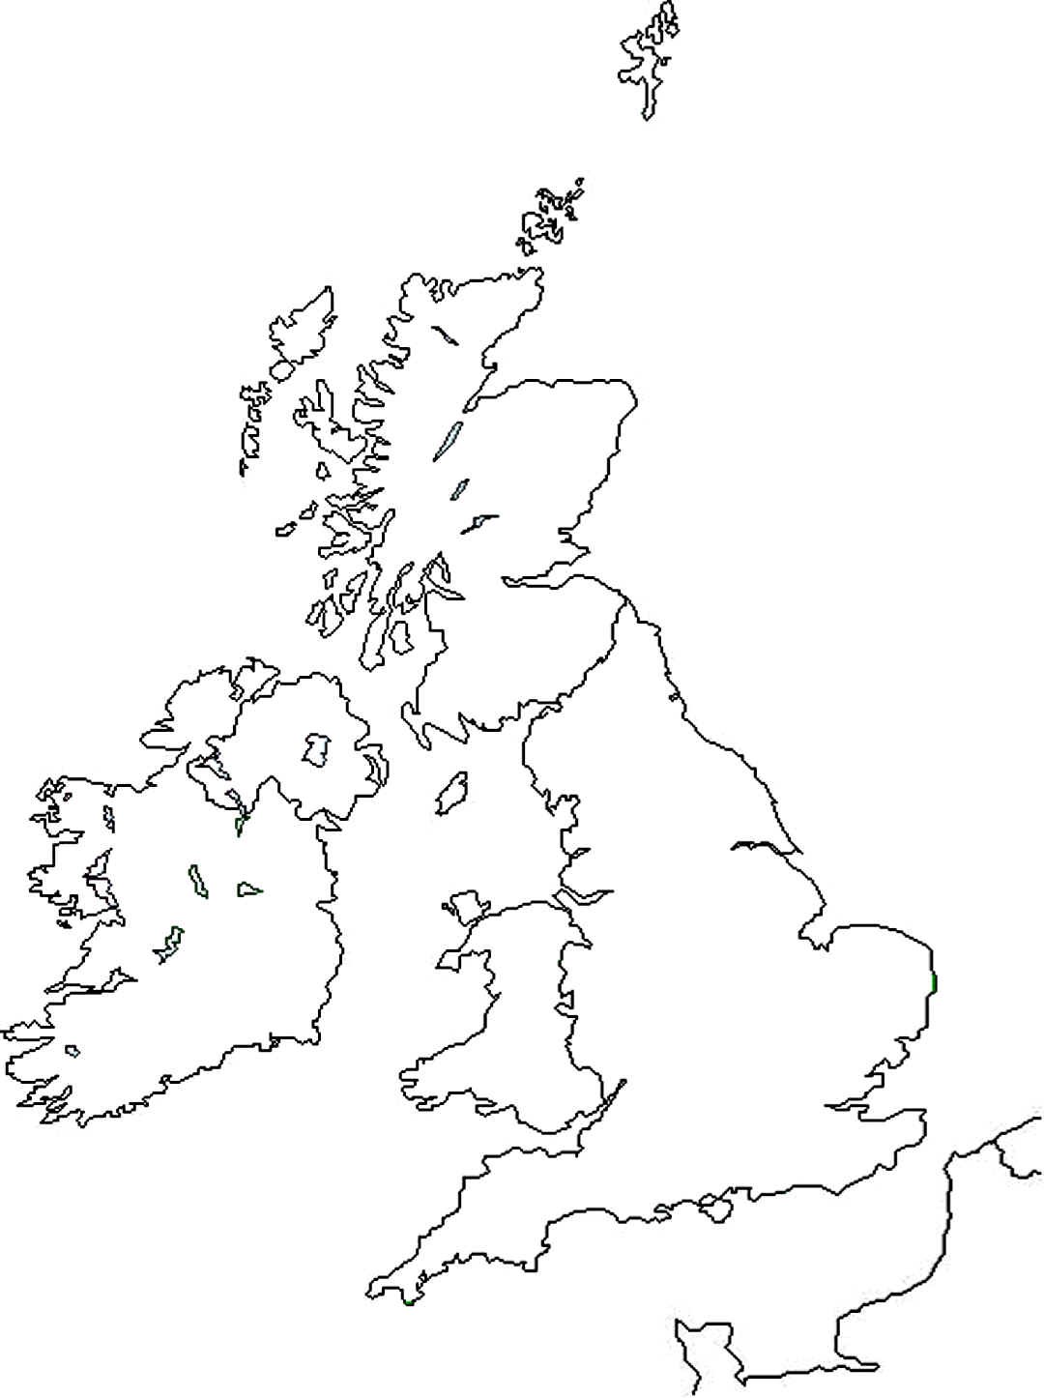
Tariffs in the NI Protocol - Background
RoW to NI movements
Goods “not at risk” = UK tariffs
Goods “at risk” = EU tariffs
UK tariffs include preferential tariffs from UK trade deals, subject to Rules of Origin.
GB to NI movements
Goods “not at risk” = Zero tariffs
Goods “at risk” = EU tariffs
UK goods can enter NI tariff-free under the UK/EU TCA, subject to Rules of Origin.
EU to NI movements
No “at risk” test – all goods in free circulation treated the same
This means no tariffs or customs controls on EU to NI movements, including across the NI/IE land border

Slide 13
At risk goods (1)
Businesses will have a range of options to reach the right outcome on the application of tariffs for goods movements into NI.
Good always at risk:
Goods subject to commercial processing in NI and the additional processing criteria is not met
Goods from outside the UK/EU where the EU duty is more than 3% greater than the UK duty
Goods automatically NOT at risk
Goods where the UK duty is equal to or higher than the EU duty
For GB-NI movements there is no UK duty so this would cover goods where the EU tariff is zero
A business may use the UK-EU TCA to claim a preferential rate of duty on entry to NI where origin requirements are met
This would mean the goods are automatically not at risk
A business does not require a UK Trader Scheme authorisation to declare these goods not at risk

Slide 14
At risk goods (2)
A business may register for the UK Trader Scheme, allowing them to declare their goods ‘not at risk’, where the goods meet the criteria below.
Goods which may be declared not at risk:
Goods for sale to or final use by, end-consumers located in the UK
  - for example, goods for sale in retail stores
Goods for business use in NI
  - for example, a business purchasing stationery, or a farmer purchasing a tractor
  A business does not need to provide supporting evidence as part of its declaration, but must hold evidence, which may be examined by HMRC on request
  Examples of evidence:
  Commercial receipts and invoices
  Commercial contracts and purchase orders
  Delivery receipts, consignment notes

Slide 15
Commercial processing
Goods brought into NI for processing are automatically at risk, unless the business meets one of the criteria:
Small processor – businesses with an annual turnover less than £500,000 pa
Approved processing sectors
  Sale of food to end-consumers in the UK
  Construction in NI
  Not for profit activities in NI
  Goods for use in health or care in NI
  Final use of animal feed in NI
Other than the sale of food the processing must be carried out by the business moving the goods into NI
Businesses who meet these criteria must inform HMRC of this when applying for the UKTS. Once authorised they may declare goods for processing not at risk. They must keep supporting evidence.

Slide 16
UK Trader Scheme
To declare goods not at risk a business must be authorised to use the UK Trader Scheme
Open to businesses in all sectors and of all sizes
Criteria:
Established in NI, or
Established in GB
  and have customs operations carried out in the UK
  and have indirect representation in NI
  and have a fixed place of business in NI where records are available and where goods are sold to, or provided for final use by end-consumers, and
Have no history of serious customs or tax infringements or other similar criminal offences of an economic nature, and
Have sufficient controls of operations and record keeping to ensure can provide evidence to support not at risk declarations
If you supply goods to a business in Northern Ireland but do not have a fixed address in Northern Ireland
Temporary approach if:
you do not have a fixed address in Northern Ireland
you supply goods to a business in Northern Ireland which has a fixed place of business from where those goods are provided for, or sold to end consumers, and that business is either:
  provisionally authorised under the UK Trader Scheme
  could be provisionally authorised, were they the importer of those goods
To be provisionally authorised to declare goods not ‘at risk’, you must
  meet all of the other UK Trader Scheme criteria
  be able to declare not ‘at risk’ for end-use or sale to end consumers in the UK
There is further detail on the application process on gov.uk

Slide 17
Waivers
Businesses can claim a waiver for duty on goods brought into Northern Ireland from Great Britain which might otherwise incur ‘at risk’ tariffs if they have not exceeded the allowances set out below at the point the import declaration is submitted.
How much you can claim
If you are eligible to claim a waiver you must do this at the point your import declaration is submitted.
Waivers for duty on goods that would otherwise incur ‘at risk’ tariffs are provided in the form of ‘de minimis aid’.
This is measured in euros.
Allowances and de minimis aid
Most businesses can claim up to a maximum of €200,000 of aid over 3 tax years, lower allowances apply for certain sectors.
The period of 3 years is assessed on a rolling basis.
The maximum allowance includes all de minimis aid you claim over a period of 3 tax years such as:
de minimis aid unrelated to waivers for Customs Duty
de minimis aid granted through any other scheme - such as Employment Allowance

Slide 18
Overview of GB-NI tariff options
Traders moving goods into NI from GB will have a range of options for reaching a zero-tariff outcome. The UKTS has been designed to be accessible to different types of traders, but not all traders will choose to use it.
The TSS will help traders to understand these options and provide information to help them choose the best approach to suit their specific circumstances.
Is EU duty zero? This includes UK-originating goods under UK/EU TCA
NO
YES
Does the trader have UKTS authorisation?
NO
YES
UK/EU Trade and Cooperation Agreement (TCA)
Traders bringing goods into NI can claim a preferential rate if their goods are UK-originating, according to the Rules of Origin (RoO) agreed in the UK/EU TCA.
This could be the best option for traders with controlled supply chains of UK goods, or traders who cannot use the UKTS because they do not qualify for one of the commercial processing exemptions.
Is the good subject EU trade defence measures?
YES
NO
Does the good meet commercial processing exceptions?
NO
YES
Does the good meet the end use criteria?
UK Trader Scheme (UKTS)
Traders can declare goods “not at risk” if they can meet the authorisation requirements and declare that their goods will be sold or used in the UK.
This could be the best option for traders bringing finished goods into NI for sale (e.g. retailers), or processors who qualify for one of the commercial processing exceptions.
NO
YES
At risk
Not at risk
Does the trader have de minimis waiver capacity?
Waivers
Instead of using the UKTS or the TCA, traders can claim a De Minimis tariff waiver.
This could be the best option for small or infrequent traders, or processors who are bringing non-UK goods into NI and who do not qualify for one of the commercial processing exceptions.
NO
YES
EU duty
Zero duty

Slide 19
Overview of RoW-NI tariff options
Is EU duty lower than or equal to UK duty?
Traders importing goods into NI from RoW will also have a range of options for ensuring they pay the UK tariff rather than the EU tariff.
Traders won’t be able to use the UK/EU TCA when moving non-UK goods into NI, but they may be able to claim preferential rates under other trade deals.
NO
YES
Does the trader have UKTS authorisation, and is EU duty within 3% of UK duty?
NO
YES
Is the good subject to EU trade defence measures?
Applicable UK and EU duties
Goods will be “not at risk” when duties payable in the UK are the same as duties payable in the EU.
This includes cases where UK and EU MFN tariffs are the same, but also when goods are eligible for preferential duties under both UK and EU trade deals (e.g. Japanese goods).
YES
NO
Does the good meet commercial processing exceptions?
NO
YES
Does the good meet the end use criteria?
NO
YES
UK Trader Scheme (UKTS)
Traders can declare goods “not at risk” as long as they can meet the authorisation requirements and declare that their goods will be sold or used in Northern Ireland.
For RoW-NI movements, there is an additional tariff differential test.
At risk
Not at risk
EU duty
UK duty

Slide 20
Scenario 1 – GB origin goods
Beef raised and slaughtered in GB and made into mince moving to NI for retail sale
Origin – GB origin
TCA – preferential rate available so EU tariff would be zero
At risk – at EU tariff would be zero, goods can automatically be declared not at risk
UKTS – there is no need to use the UKTS in this scenario, although it would be available as the goods are for retail sale in NI

Slide 21
Scenario 2 – non-GB origin goods
Tomatoes grown in Spain imported to GB to the supermarket’s distribution hub, subsequently moving to NI for retail sale
Origin – Spanish origin
TCA – Goods are not GB origin, so the TCA preferential rates are not available on entry to NI
At risk – can be declared not at risk as the goods are for retail sale in NI
UKTS – the person responsible for declarations for moving the goods into NI would need to meet the conditions of the UKTS to be authorised and declare goods not at risk

Slide 22
Scenario 3 – goods moving into NI for processing
Beef raised and slaughtered in GB moved into NI for processing into food products for sale to retail stores in NI
Origin – GB origin
TCA – Goods are GB origin, so the TCA preferential rate is available, the goods can be automatically declared not at risk
If the goods were not GB origin – say NZ lamb instead
At risk – can be declared not at risk if the goods meet the approved processing sector criteria for the UKTS
UKTS – the person responsible for declarations for moving the goods into NI would need to meet the conditions of the UKTS to be authorised and declare goods not at risk

Slide 23
Trader Readiness – Steps to Take
Register for TSS by visiting: https://www.tradersupportservice.co.uk/tss
Sign up to TSS training courses: https://www.nicustomstradeacademy.co.uk/
Identify if you need to seek additional professional advice on the most suitable customs arrangements to meet your specific needs
See the latest guidance https://www.gov.uk/guidance/trading-and-moving-goods-in-and-out-of-northern-ireland-from-1-january-2021

